Slide 1
Users and Permissions

Slide 2

Django Admin
Create and modify users or user groups Grant or revoke permissions for individuals and user groups

Slide 3
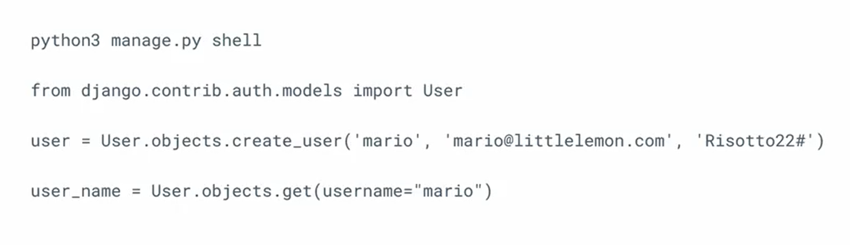
Django Shell

Slide 4


Slide 5
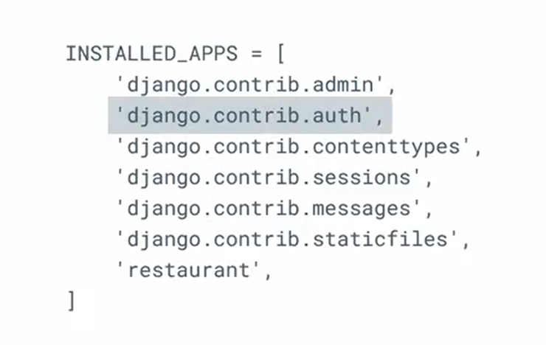
settings.py

Slide 6
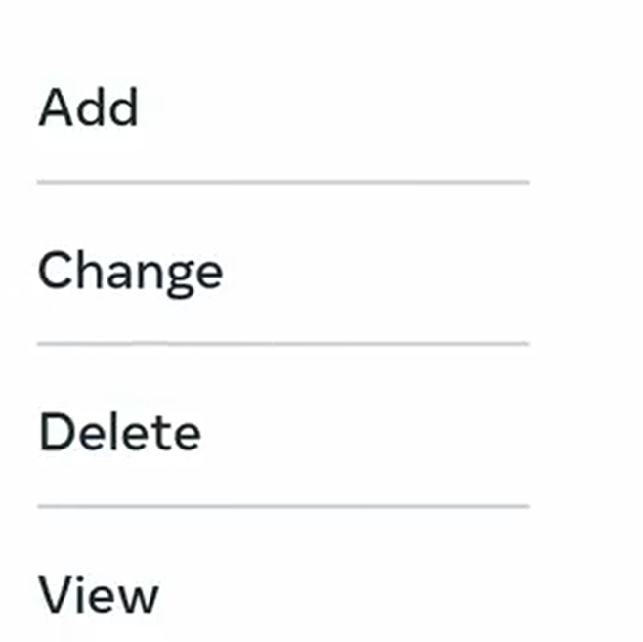

Slide 7


Slide 8
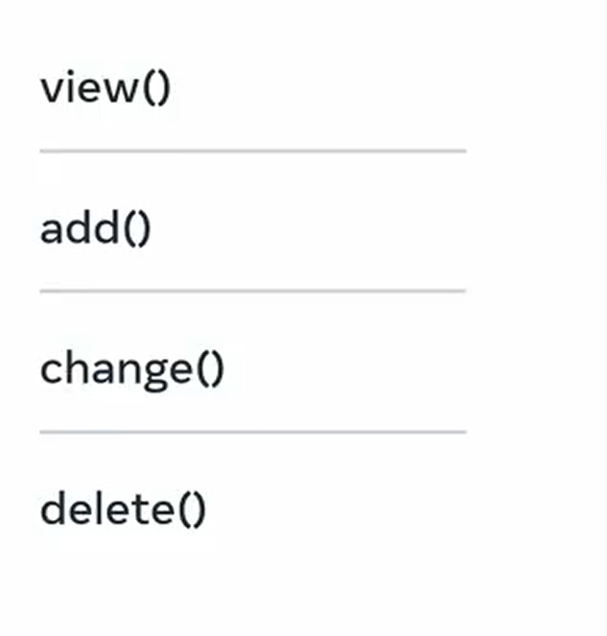

Slide 9


Slide 10

User permissions
Store and references a single or multiple permissions objects

Slide 11
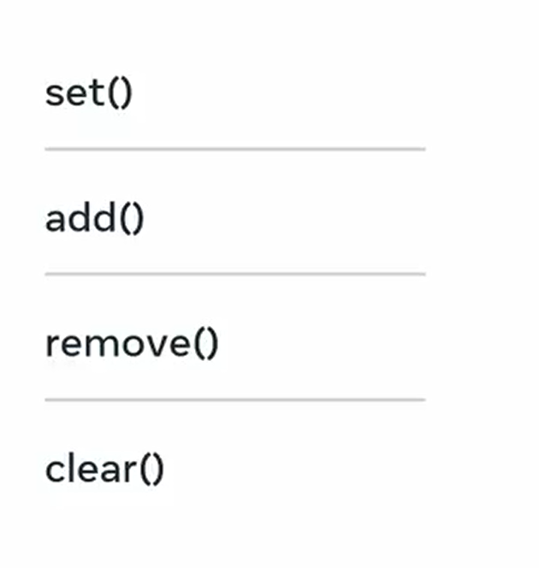

Slide 12
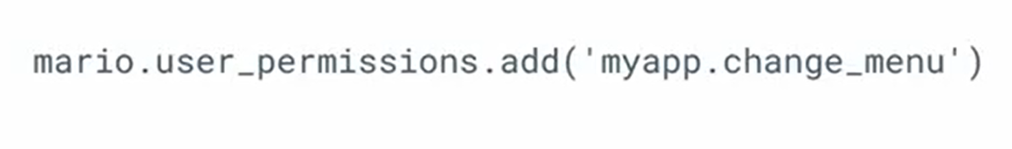
Add() method

Slide 13
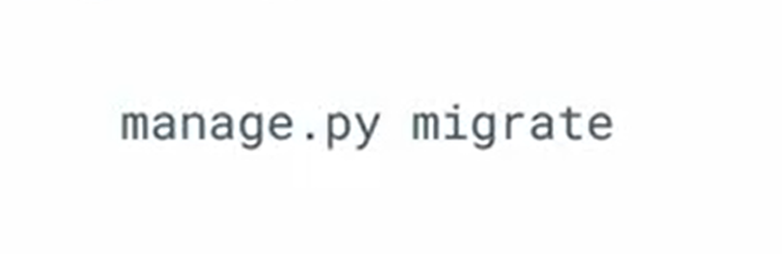
Django model

Slide 14
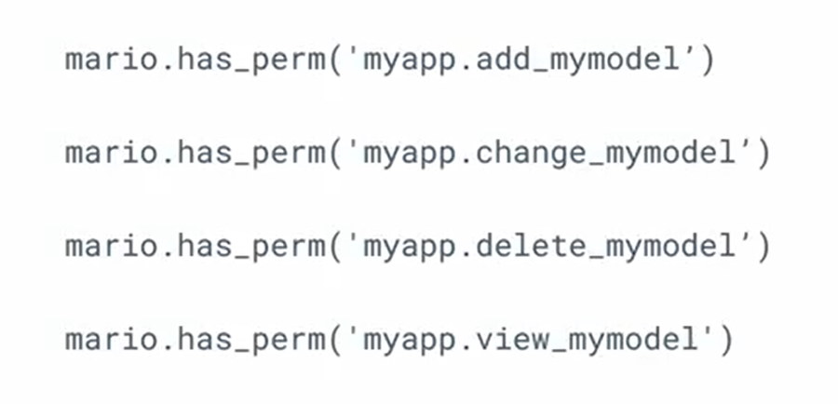
mymodel

